Slide 1
ET 8311 TELE TRAFFIC ENGINEERING
Name: Joseph Sospeter Salawa
Contacts: 0754556575
Email: yusufujss@gmail.com

Slide 2
Introduction
Teletraffic theory is defined as the application of probability theory to the solution of problems concerning planning, performance evaluation, operation and maintenance of telecommunication systems.
More generally, teletraffic theory can be viewed as a discipline of planning where the tools (stochastic processes, queuing theory and numerical simulation) are taken from operations research.
The term teletraffic covers all kinds of data communication traffic and telecommunication traffic.

Slide 3
Cont...
The objective of teletraffic theory can be formulated as follows:
to make the traffic measurable in well defined units through mathematical models
derive the relationship between grade-of-service and system capacity in such a way that the theory becomes a tool by which investments can be planned".

Slide 4
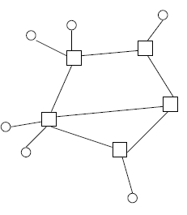
Telecom Networks
A simple model of a telecommunication network consists of
– nodes
• terminals
• network nodes
– links between nodes
• Access network
– connects the terminals to the network nodes
• Trunk network
– connects the network nodes to each other

Slide 5
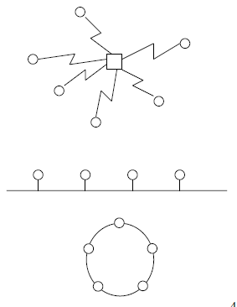
Cont...
In the previous model,
– connections between terminals and network nodes are point-to point type (no resource sharing within the access netw.)
• In some cases, such as
– mobile telephone network
– local area network (LAN) connecting computers the access network consists of shared medium:
– users have to compete for the resources of this shared medium
– multiple access (MA) techniques are needed

Slide 6
Switching modes
• Circuit switching
– telephone networks
– mobile telephone networks
– optical networks
• Packet switching
– data networks
– two possibilities
• connection oriented: e.g. X.25, Frame Relay
• connectionless: e.g. Internet (IP), SS7 (MTP)
• Cell switching
– ATM networks
– connection oriented
– fast packet switching with fixed length packets (cells)

Slide 7
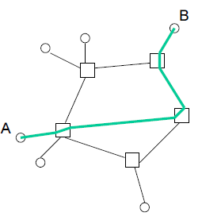
Circuit switching
Connection oriented:
– connections set up end-to-end before information transfer
– resources reserved for the whole duration of connection
– if resources are not available, the call is blocked and lost
• Information transfer as continuous stream

Slide 8
Cont...
Before information transfer
– Set-up delay
• During information transfer
– signal propagation delay
– no overhead
– no extra delays
• Example: telephone network

Slide 9
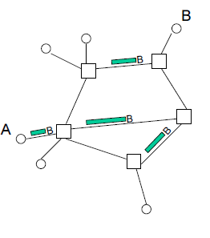
Connectionless packet switching
Connectionless:
– no connection set-up
– no resource reservation
– no blocking
• Information transfer as discrete packets
– varying length
– global address (of the destination)

Slide 10
Cont...
Before information transfer
– no delays
• During information transfer
– overhead (header bytes)
– packet processing delays
– queuing delays (since packets compete for joint resources)
– transmission delays (due to finite capacity links)
– signal propagation delay
– packet losses (due to finite buffers)
• Example: Internet (IP-layer)

Slide 11
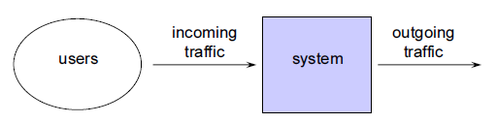
Traffic point of view
Telecommunication system from the traffic point of view
Ideas:
– the system serves the incoming traffic
– the traffic is generated by the users of the system

Slide 12
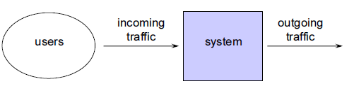
Interesting questions
Given the system and incoming traffic, what is the quality of service experienced by the user?
• Given the incoming traffic and required quality of service, how should the system be dimensioned?
• Given the system and required quality of service, what is the maximum traffic load?

Slide 13
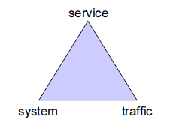
Cont...
Determine relationships between the following three factors:
– quality of service
– traffic load
– system capacity

Slide 14
Cont...
System can be
– a single device (e.g. link between two telephone exchanges, link in an IP network, packet processor in a data network, router’s transmission buffer, or statistical multiplexer in an ATM network)
– the whole network (e.g. telephone or data network) or some part of it
• Traffic consists of
– bits, packets, bursts, flows, connections, calls, …
– depending on the system and time scale considered
• Quality of service can be described from the point of view of
– the customer (e.g. call blocking, packet loss, packet delay, or throughput)
– the system, in which case we use the term performance (e.g. processor or link utilization, or maximum network load)

Slide 15
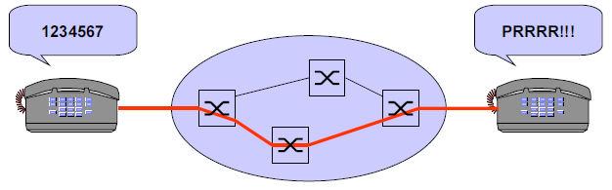
Example
Telephone call
– traffic = telephone calls by everybody
– system = telephone network
– quality of service = probability that the phone rings at the destination

Slide 16
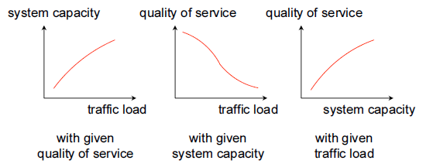
Relationships between the three factors
Qualitatively, the relationships are as follows:
To describe the relationships quantitatively, mathematical models are needed

Slide 17
Teletraffic models
Teletraffic models are stochastic (= probabilistic)
– systems themselves are usually deterministic but traffic is typically stochastic
– “you never know, who calls you and when”
• It follows that the variables in these models are random variables, e.g.
– number of ongoing calls
– number of packets in a buffer
• Random variable is described by its distribution, e.g.
– probability that there are n ongoing calls
– probability that there are n packets in the buffer
• Stochastic process describes the temporal development of a random variable.

Slide 18
Cont...
Three types of system models:
– loss systems
– queuing systems
– sharing systems
• These models can be combined to create models for whole telecommunication networks
– loss networks
– queuing networks
– sharing networks

Slide 19
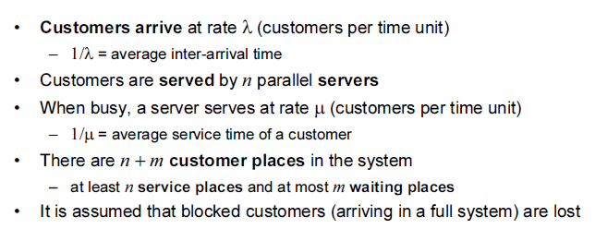
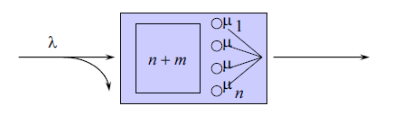
Simple teletraffic model

Slide 20
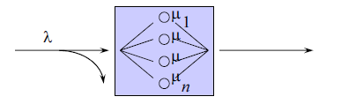
Pure loss system
Finite number of servers (n < &), n service places, no waiting places (m = 0)
– If the system is full (with all n servers occupied) when a customer arrives, it is not served at all but lost
– Some customers may be lost
• From the customer’s point of view, it is interesting to know e.g.
– What is the probability that the system is full when it arrives?

Slide 21
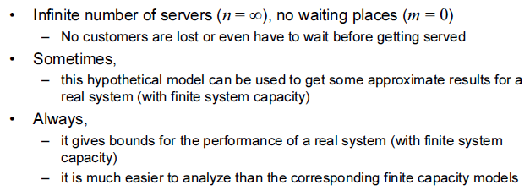
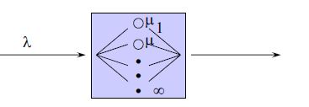
Infinite system

Slide 22
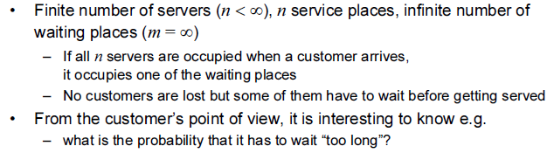
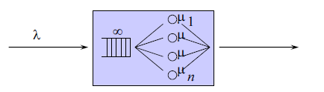
Pure queuing system

Slide 23
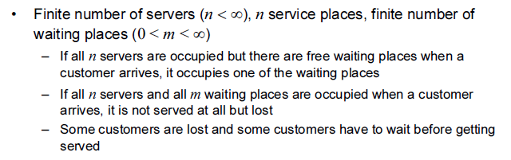
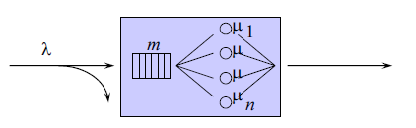
Lossy queuing system

Slide 24
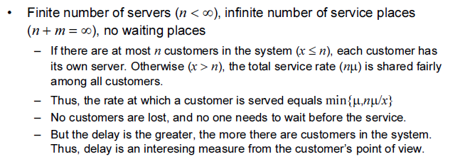
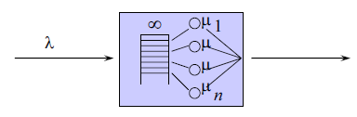
Pure sharing system

Slide 25
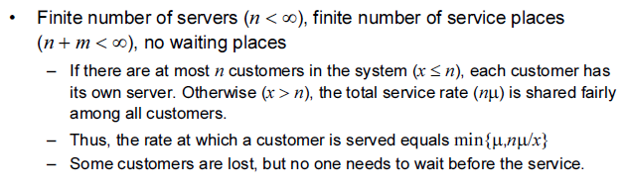
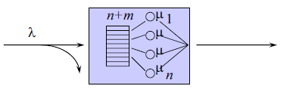
Lossy sharing system

Slide 26
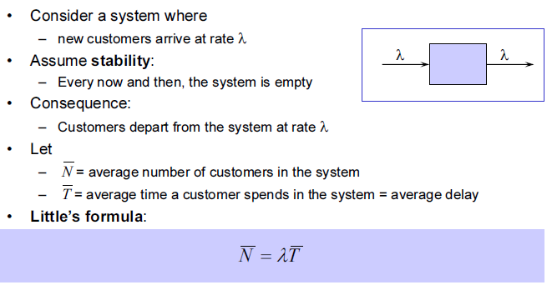
Little’s formula

Slide 27
Example
Imagine there is an offline clothes store that wants to optimize its checkout process on both normal and sale periods:
On an average on day-to-day basis, 24 customers are arriving every hour
On average, they take 40 minutes (approximately 0.6 hours) to find a dress, pay, and leave
How many customers are in the shop at all time?

Slide 28
END

